Slide 1
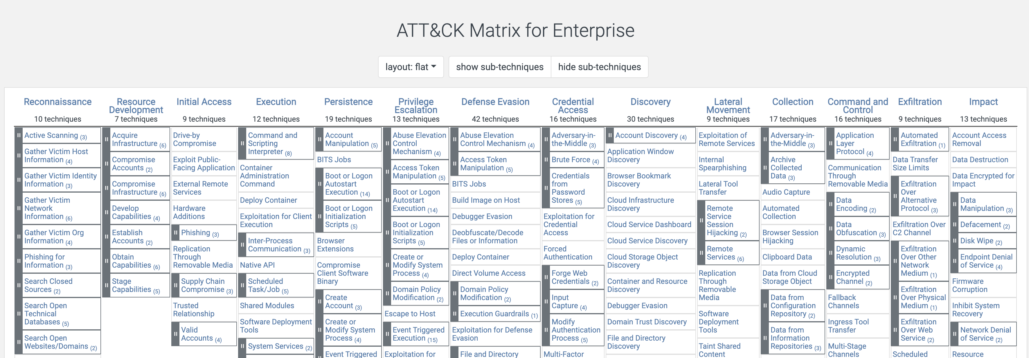
MITRE ATT&CK
https://attack.mitre.org/
Today we will be looking at Collection.

Slide 2
Collection

Slide 3

Collection
What is Collection?
This is the process of collecting data, sometimes staging it for later exfiltration.
Collection goes through micro-iterations, in addition to the macro-level.
Some Examples:
Collect data from the local host(s) compromised.
Pull data from an exploited application.
Data from information repositories (e.g., file shares, code repositories).
Extract data from cloud storage.
Adversary in the Middle (covered during credential access).
Input capture (e.g., keylogging, web page capture).
BEC: Business Email Compromise (e.g., mail or contact dumping).

